Slide 1
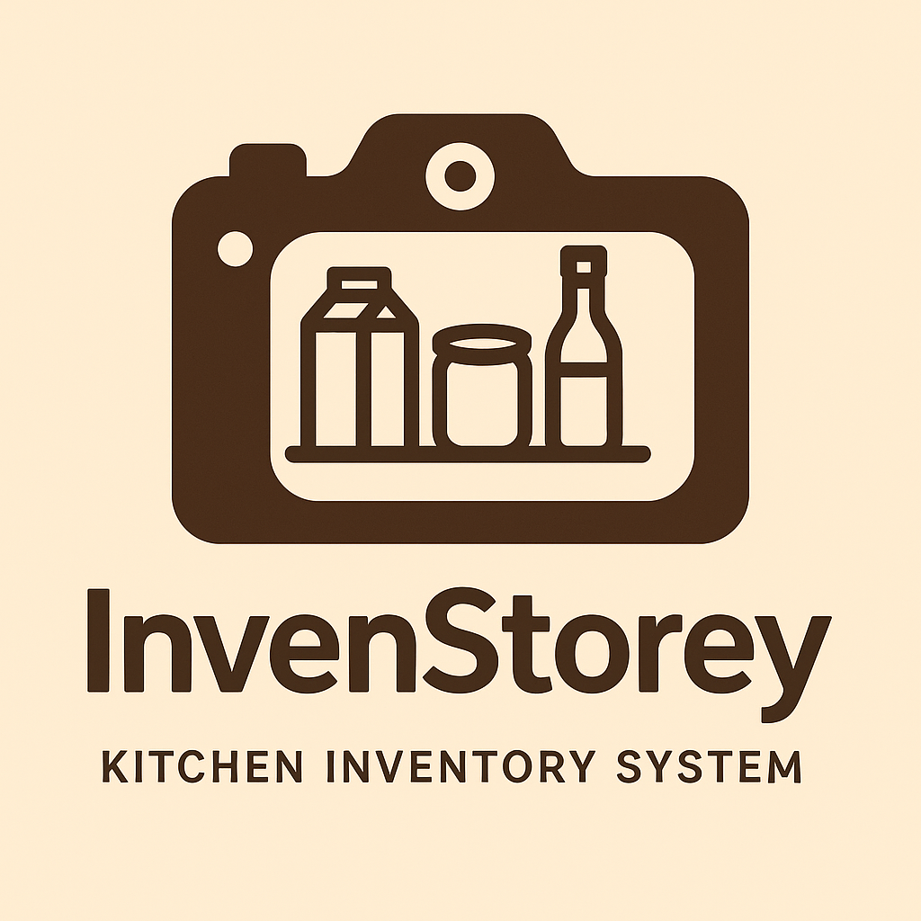
InvenStorey Pitch Presentation
By: Naami Barnor,Ash Bailey, Jared Cambridge, Raquel Martin, Alonso Gonzalez-Hernandez
Date: 7/27/2025
Smart Storage. Better Storeys.

Slide 2
Inventory Management Made Simple
What is InvenStorey?
-InvenStorey is a restaurant focused, AI powered inventory tracking, ordering, and forecasting system that encapsulates all inventory management needs.
-InvenStorey’s software has been thoroughly tested and applied to over 200 POS and inventory management systems, allowing for seamless integration with current systems.

Slide 3
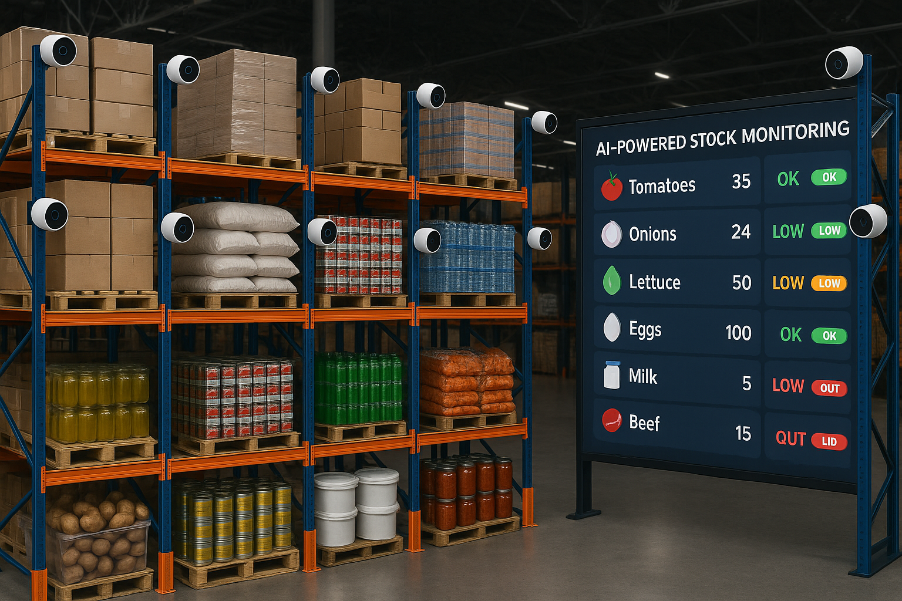
How does it work?
Integration and Automation At Every Level
-Through camera tracking and POS integration, InvenStorey AI automatically detects what, and how much of a product or material has been moved from your shelves, refrigerators, or machinery, removing the need for managers and employees to spend hours counting stock and ordering new materials manually.
-InvenStorey simplifies kitchen management by tracking all inventory and automating reordering through vendor integrations reducing manual effort and minimizing food waste.
-InvenStorey supports streamlined ordering from suppliers like Sysco,US Foods, and Performance Foodservice, allowing businesses to keep their current vendors.

Slide 4


“Why InvenStorey?”
01
Works with any supplier or vendor
Vendor-Flexible
02
Uses AI and cameras to track inventory
Smart Automation
03
Saves time, cuts waste & overstock
Cost Effective
InvenStorey is designed to work with any vendor. We pride ourselves as being vendor-agnostic. Whether a restaurant orders from Sysco, U.S. Foods, or a local farm, they can keep their current vendors. Our system is designed to adapt not disrupt.

Slide 5
The Foundation
Breakdown of the product, its purpose, and what makes it unique.

Slide 6
Project Purpose
1
2
3
4
InvenStorey
Prevent Costly Inventory Stocking Errors
Built for Simplicity and Reliability
Save Time & Protect Profits
AI- Powered Insights for Smarter Decisions
Helps prevent overstocking, understocking, and human error through real-time tracking and automation.
Designed to be easy to use and dependable—no complicated systems, just what busy restaurants need.
Streamlines inventory tasks to reduce waste, save time, and avoid profit loss from stock issues.
Uses data and AI to provide insights that improve ordering, reduce waste, and boost efficiency.

Slide 7


Core Objectives
Problem
Purpose
Objectives
Manual Inventory tracking causes inefficiency and waste leading to:
-Inaccurate stock levels
-Increased labor costs
-Human error
To streamline restaurant inventory using a smart tracking system.
Help restaurants manage stock efficiently with minimal manual effort
Automate inventory tracking
Enable auto-restock triggers
Reduce waste and overstock
Improve kitchen productivity

Slide 8



Project Overview
Project Goals
Reduce time spent on manual inventory tracking tasks by at least 60% within 6 months of implementation
Decrease food spoilage by 30% through real-time stock visibility and usage analytics
Achieve 90% accuracy in reordering through auto replenishment

Slide 9
The Business Case
Operational Efficiency & Cost Reduction
1
2
Revenue Protection & Growth
1
2
Market Expansion & Competitive Edge
1
2
InvenStorey
Q3 / July
2025
Manual inventory tracking is time-consuming and error-prone, leading to wasted time, food, and money. InvenStorey streamlines these processes, enabling restaurants to operate more efficiently.
Labor Optimization: Reduces time spent on stock checks, freeing up staff for higher-value tasks.
Waste Reduction: Predictive insights help avoid over-purchasing and spoilage.
Stock-related mistakes often result in missed sales opportunities and customer dissatisfaction. InvenStorey helps restaurants stay stocked and ready to serve, even during peak hours.
Sales Continuity: Prevents service disruptions by ensuring key items remain in stock.
Higher Profit Margins: Improved inventory accuracy translates into fewer losses and more consistent revenue.
As restaurants adopt smarter tech, InvenStorey positions its users as forward-thinking and reliable in the eyes of customers and partners.
Improved Market Positioning: Early adoption of AI tools enhances brand reputation and draws tech-forward partners.
Customer Retention: Accurate stock control improves service quality, boosting loyalty and repeat business.

Slide 10
Project Planning
Structuring the timeline, tasks, and deliverables for a smooth rollout.

Slide 11
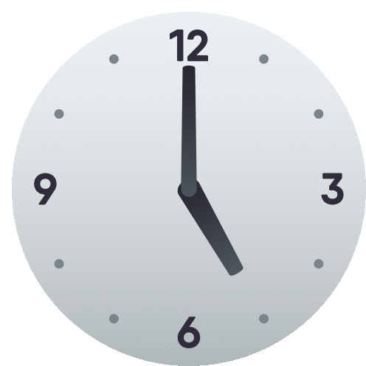

Project Overview
Estimated Run time:
Budget:
Begin date:7/23/25
End date :6/22/26
System Development and Integration:
$100,000
Marketing and Promotion:
$200,000
Infrastructure and Deployment:
$150,000
Miscellaneous and Contingencies:
$150,000
52 weeks
$600,000

Slide 12
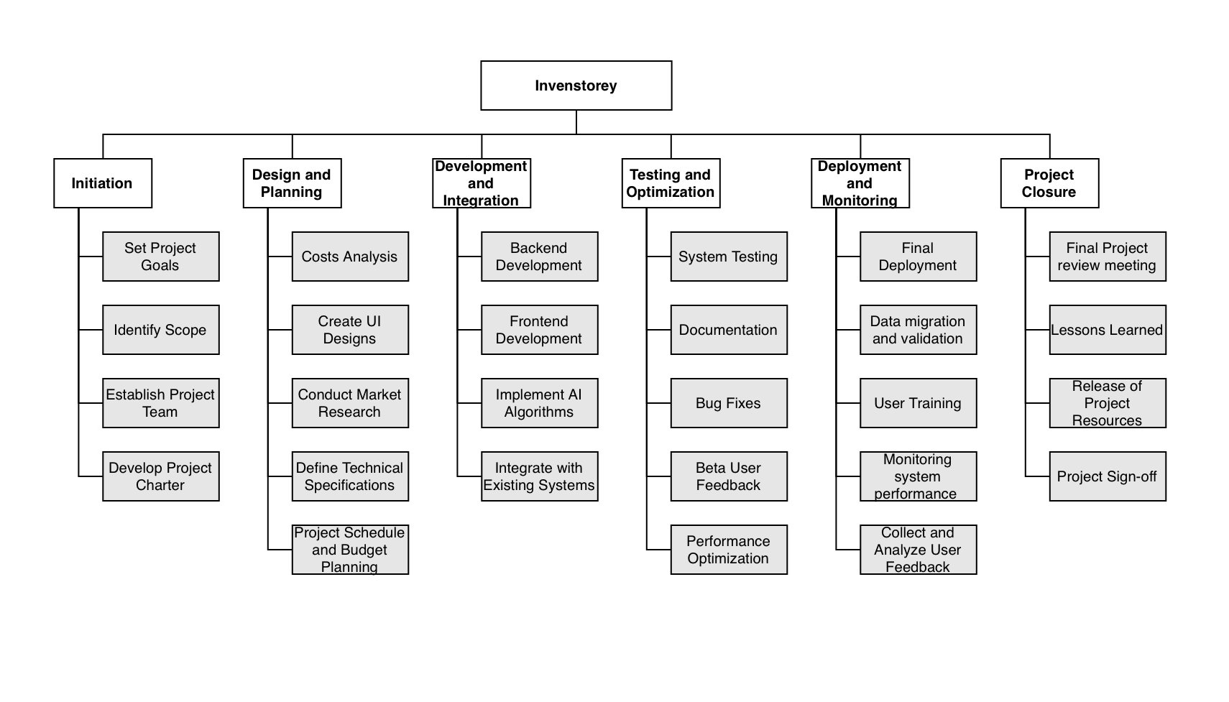
Work Breakdown Structure

Slide 13
WBS - Task List with Tentative Schedule
Project Initiation
2. Designing and Planning
Task | Assigned To | Dates
Assess Inventory Challenges | Business Analyst | 7/23/25–7/28/25
Define Scope and Goals | Project Manager | 7/25/25–7/30/25
Gather Preliminary Requirements | Business Analyst | 7/31/25–8/7/25
Evaluate Feasibility | Business Analyst | 8/8/25–8/13/25
Identify Stakeholders | Project Manager | 8/14/25–8/20/25
Get Initial Buy-in | Project Manager | 8/21/25–8/23/25
Task | Assigned To | Dates
Form Team & Plan | Software Architect | 8/24/25–8/31/25
Identify Operational Needs | Software Architect | 9/1/25–9/8/25
Assign Roles | Software Architect | 9/8/25–9/11/25
Requirements Analysis | Software Architect | 9/12/25–9/14/25
Evaluate Current Systems | Software Architect | 9/15/25–9/22/25
Assess Vendor Integrations | Software Architect | 9/23/25–9/30/25
Determine Integration Points | Software Architect | 10/1/25–10/8/25
Cost-Benefit Analysis | Software Architect | 10/9/25–10/16/25
Finalize Vendor & Tech | Software Architect | 10/17/25–10/23/25
Detailed Project Plan | Software Architect | 10/24/25–10/26/25
Define Features | Software Developer | 10/27/25–10/28/25
Set Milestones | Software Developer | 10/29/25–11/18/25
Estimate Budget | Software Developer | 11/19/25–12/4/25
Identify Risks | Operations | 12/5/25–12/20/25
Create Wireframes | Software Developer | 12/21/25–1/5/26

Slide 14
WBS - Task List with Tentative Schedule Continued
3.Execution
4.Monitoring and Control
5.Project Closure
Task | Assigned To | Dates
Conduct Data Audit | Data Engineers | 1/6/26–1/10/26
Legal Analysis & Contracts | Legal Team | 1/11/26–1/20/26
Hardware Installation | IT Specialists | 1/21/26–1/27/26
POS Integration | IT Specialists | 1/28/26–2/11/26
User Training | QA & IT Specialists | 2/12/26–2/15/26
Monitor QA Test Users | Devs & Business Analysts | 2/16/26–2/22/26
Implement Feedback | Software Developer | 2/23/26–3/16/26
Task | Assigned To | Dates
Risk Assessment | Risk Management Team | 3/17/26–4/6/26
Performance Monitoring | PM & Data Analysts | 4/7/26–5/4/26
User Feedback | PM & Marketing | 5/5/26–5/11/26
Bug Resolution | QA & Developers | 5/12/26–5/25/26
Validate Deliverables | QA & Developers | 5/26/26–6/8/26
Task | Assigned To | Dates
Final App Deliverable | QA Tester | 6/9/26–6/11/26
Project Review | Project Manager | 6/12/26–6/14/26
Final Reflection | PM & Team | 6/15/26–6/17/26
Project Sign-Offs | Project Manager | 6/18/26–6/20/26
Finalize Contracts | Legal Team | 6/21/26–6/22/26
Release Resources | Project Manager | 6/22/26
Team Celebration | PM & Team | 6/22/26

Slide 15
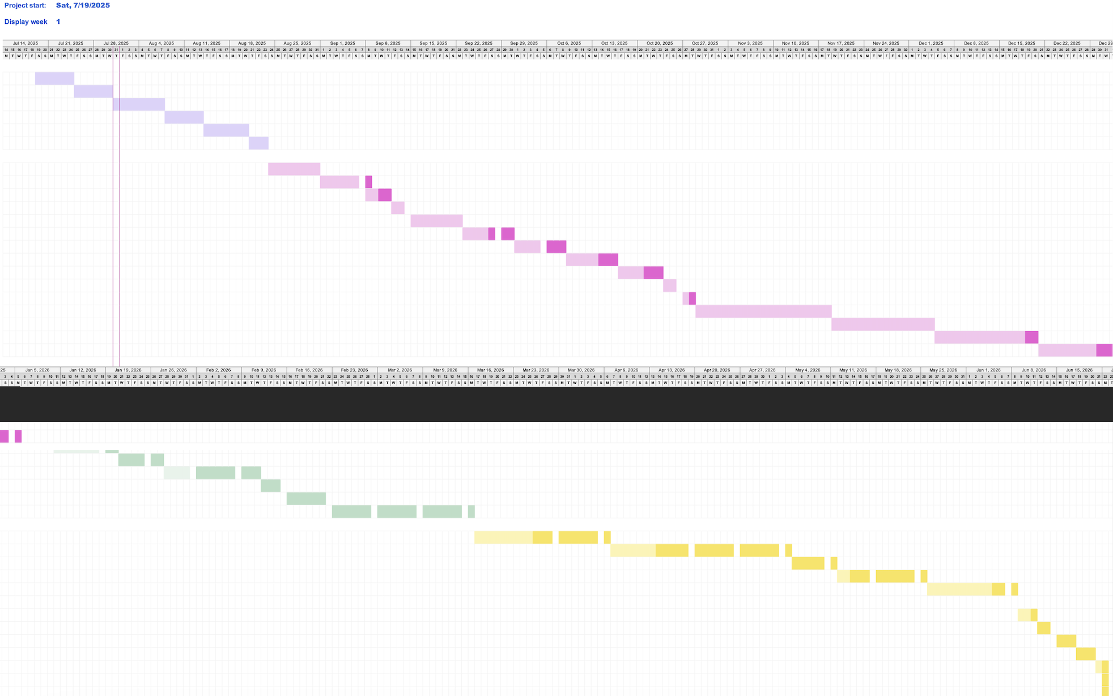
Gantt Chart

Slide 16
Cost and Vendors
Evaluating solutions and outlining a cost-effective implementation.

Slide 17
Project Budget
Invenstorey System Project
Initial Budget Estimate
Annual Operating Costs
The initial budget for the project was at $600,000, and it was designed to cover up all startup needs. This budget included development of the app , marketing and promotional efforts infrastructure and deployment setup , and extra money for miscellaneous costs.
To keep the business operational for years to come , we have estimated annual operating costs to be at $2,650,000. This will cover yearly expenses like employee salaries , office rent (HQ), and continuous system maintenance. These cost are crucial for our team and for the app to run.
Development
$100,000
Employee Salaries ( 30 people @ $80,000)
$2,400,000
Marketing and Promotion
$200,000
Office Rent
$180,000
Infrastructure & Deployment
$150,000
System Maintenance
$70,000
Miscellaneous:
$150,000
Total Annual Operating Costs :
$2,650,000

Slide 18
Project Cost Estimates
For the successful development of InvenStorey an initial Investment of $600,000 is necessary followed by an annual costs of $2,650,000
Software and Development -
Miscellaneous and Contingencies-
$100,000
$150,000
Marketing and Promotion -
Employee Salaries (Yearly)-
System Maintenance and Server Upkeep-
$200,000
$2,400,000
$70,000
Infrastructure and Deployment-
Rent and Office Space-
$150,000
$180,000

Slide 19
Vendor Selection
1
2
3
4
InvenStorey
Identify key needs for restaurant inventory
Evaluate Options
Compare and Analyze
Select and Integrate
We looked into Smart Shelving (accurate but expensive), Multi-Point Tracking (integrated but error-prone), different camera options, and a Custom AI System. Each was evaluated based on cost, scalability, and ease of use.
Real-time tracking
POS compatibility
Affordability
AI-based forecasting
Work with both small businesses and larger chains.
We conducted a cost-benefit analysis for different camera systems and considered price, scalability, security features, software capabilities, and quality.
We selected Axis for our cameras after the analysis. The next slide shows our process. And selected a custom AI-powered POS system. It allowed us to control development, scale easily, and tailor features for our users, ensuring the best mix of cost efficiency and innovation.

Slide 20
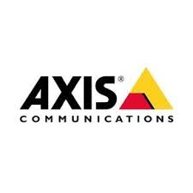

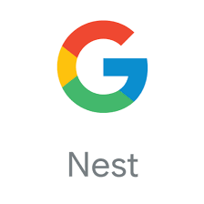


Scalability | Highly Scalable- Excellent integration with business-grade software. Designed for commercial use. | Moderately scalable-Good for homes and small businesses limited support for advanced integrations | Limited Scalability-Best for individual users or homes less suited for enterprise-level growth. | Limited to moderate scalability-Difficult to integrate with business systems not scalable | Low Scalability- Hard to scale, limited integration with advanced systems
Security Features | Advanced security End-to-end encryption, secure boot, firmware signing, strong compliance standards | Good security – 2FA, encrypted cloud storage, but some past vulnerabilities reported | Strong security – Tightly integrated with Google ecosystem, regular updates, 2FA. | Improved but mixed-End-to-end video encryption available but optional; past privacy controversies. | Weak Security-Previous major data breach, basic protections, slower update rollout
Price | Very High-$500-$1500/ camera | High- $100-$300/ camera + cloud | High-$130–$250/camera +sub | Moderate-$60–$200/camera + sub | Low- $30–$60/camera + optional sub
Software Capabilities | Enterprise-grade software – Open API, VMS integrations, custom analytics, remote configuration | Good app-limited pro-tools User friendly but limited 3rd party integration | Smart integrations-Strong with Google Home/ Assistant, AI alerts, facial recognition | Simple software – Integrates with Alexa, but fewer advanced analytics; mostly event-based notifications | Very basic software – Some AI detection, but laggy app, limited 3rd-party support, less customizable
Camera Quality and Reliability | Professional-grade cameras – Wide variety (HD, 4K),high durability, weatherproof, consistent uptime | High-quality consumer cameras – 2K–4K resolution, good night vision; some users report firmware bugs | Excellent quality – High resolution (up to 4K), reliable alerts, strong AI processing. | Good for price – HD video, okay night vision; lower reliability in harsh weather or shared Wi-Fi networks. | Budget quality – Decent in daylight, poor night vision and hardware durability.

Slide 21

✓= Strong / Leading ½ = Moderate / 50-50 ✗ = Weak / Not Suitable
Scalability | ✓ | ✗ | ½ | ✗ | ✗
Security Features | ✓ | ✓ | ½ | ½ | ✗
Price | ✗ | ✓ | ½ | ✓ | ✓
Software Capabilities | ✓ | ✗ | ✓ | ½ | ✗
Camera Quality and Reliability | ✓ | ✓ | ½ | ½ | ✗
Although Axis had the highest upfront cost, it was selected due to its superior performance in inventory accuracy, software capabilities, and system reliability. Over time, the reduction in waste, errors, and manual labor costs offsets the initial investment providing a stronger long-term ROI.

Slide 22
Risks and Success
Anticipating challenges while defining strategies for success.

Slide 23
Project Risks and Challenges
-Client resistance to new technologies
-System Integration Challenges
-Data Security risks
-Lack of employee training and utilisation
-Vendor Delays
-Camera malfunction
-Data Migration Delays
-Inventory regulation requirements
In order to ensure a smooth, successful launch and implementation phase, InvenStorey must assess all risks and threats that come with the development of an inventory management system to prevent failure down the line.

Slide 24
Mitigation
-Client resistance to new technologies - Full, clear explanations of the system and its benefits
-System Integration Challenges - InvenStorey technicians handle integration and address compatibility concerns
-Data Security risks - Data held on private servers; cyber security team on call 24/7
-Lack of Employee Training and Utilisation - Provide comprehensive training courses for a fee
-Vendor Delays - Delays and costs associated fall on the vendors, as per written agreement
-Camera Malfunction - provide troubleshooting support via IT helpdesk, camera replacement can be performed in house with no technician required
-Inventory Regulation Requirements - the InvenStorey system can be customized and modified in any way necessary, can be tailored to fit any regulatory standard

Slide 25
Key Performance Indicators
(KPI)
Benchmarks built from the goals set and exceeded.

Slide 26
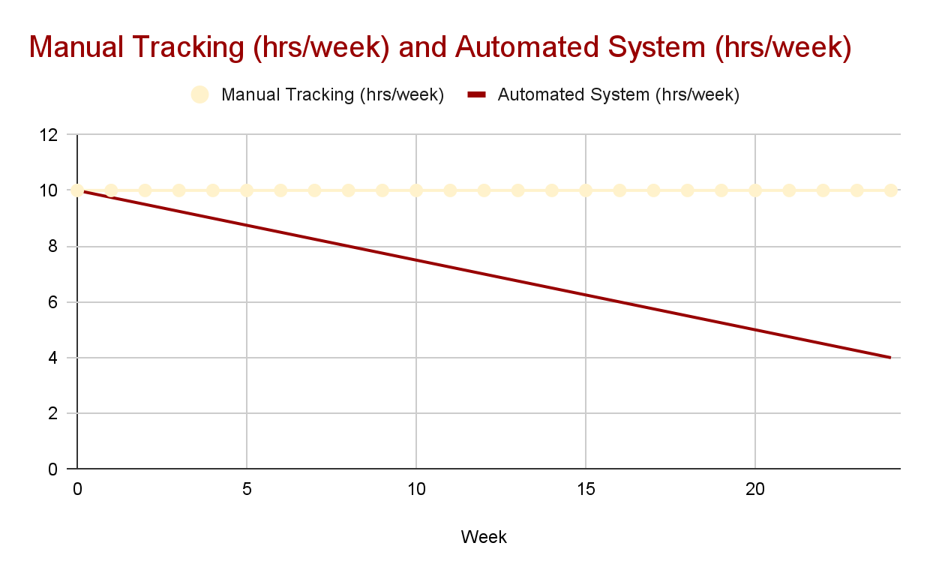
Time Saved in Automated Tracking
Decreased manual inventory tracking time by 60% in 26 weeks
Saved ~8–10 hours per week for kitchen staff
Allowed reallocation of labor to prep and customer service
hours

Slide 27
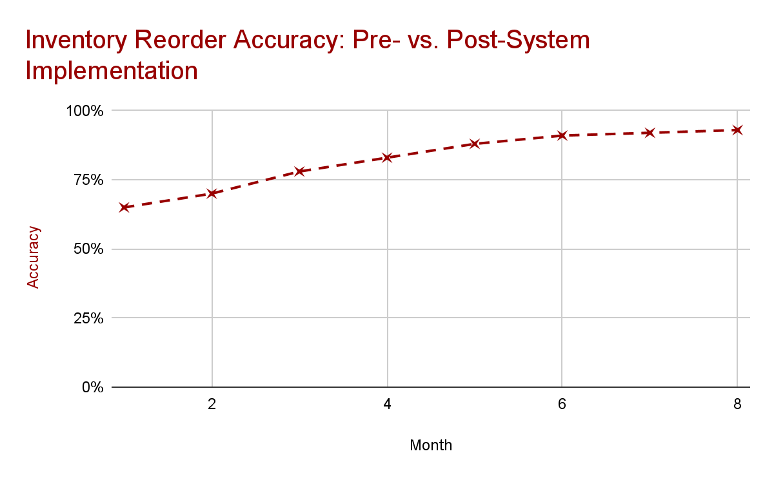
Reorder Accuracy Improvement
Achieved 90% reorder accuracy by Week 20 using automated system
Reduced manual entry errors by 75%
Improved stock availability and customer satisfaction

Slide 28
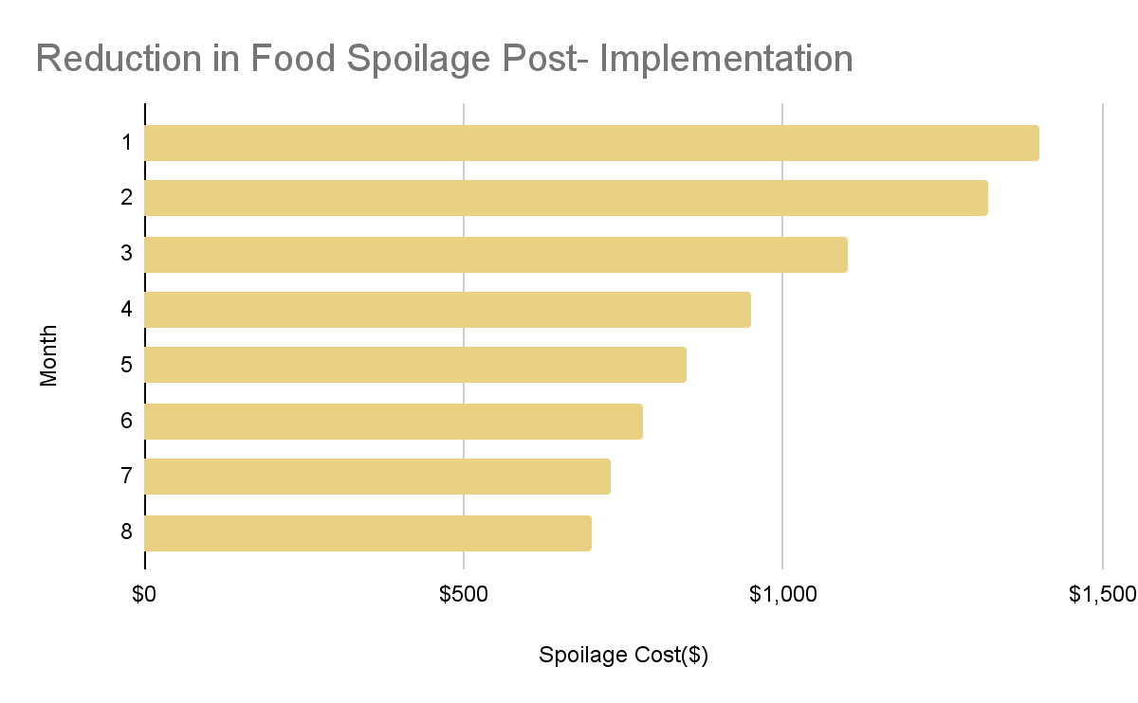
Reduction in Inventory Spoilage
Exceeded expectations by cutting food spoilage by over 50% over 8 months
Reduced over-ordering through smart threshold detection
Improved shelf-life tracking and minimized food waste

Slide 29


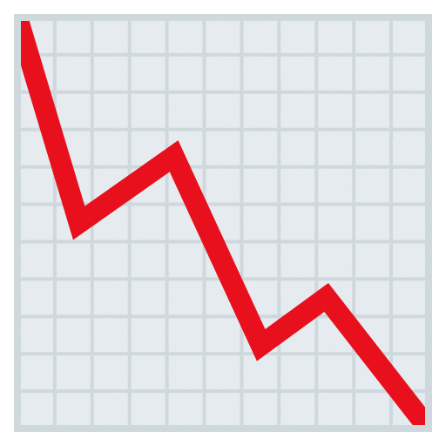
Suggested Future Enhancements for Ongoing Growth
1. AI Demand Forecasting
2. Restricted Access based on role
3. Smart Camera Expansion
4. Advanced Analytics Dashboard
Today’s agenda
Let teams assign different user roles(manager,chef etc.) with specific permissions.
Wider coverage with object recognition for more perishable items.
Add dashboards with waste trends and cost saving opportunities for smarter decision making.
Predict reorder timing based on usage trends.

Slide 30
Ready to Take Stock?✓
Final recap and request for approval to move forward.

Slide 31
Summary and Approval Request
InvenStorey
Summary
Approval
The project was completed within the planned 12-month timeline.
Delivered on budget, with resources managed effectively.
All milestones were met, including design, development, testing, and deployment.
Implemented in over 200 restaurants nationwide.
Reduced food waste by 30% and inventory tracking time by 60%.
Achieved 95% system uptime and 20% ROI in the first year.
Strengthened vendor relationships with Axis Communications.
Positioned restaurants as forward-thinking and competitive in the market.
Improved employee efficiency and overall customer satisfaction.
Based on all of the success we have had, we respectfully request stakeholder approval to officially close the InvenStorey project.
Your approval confirms that objectives have been met and ensures continued support for future growth and enhancements.

Slide 32

Thank you
info@InvenStorey.com 📞555-355-5663 www.InvenStorey.com

